Slide 1
Lecture 5: Data Visualization

Slide 2
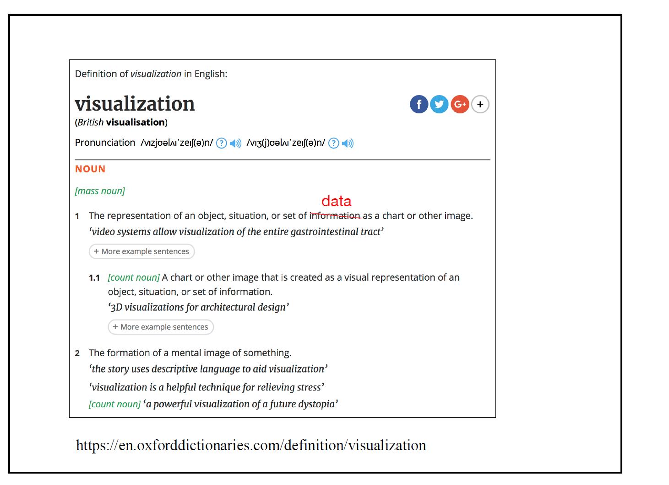
What is visualization
Here: we refer to “data” instead of “information”, more suitable
Credit: CS2990 Dr. Steichen

Slide 3
Visualization: From Data to Information
Data alone are not enough to establish a communicative process.
To give meaning to data, they must first be processed, organized, and presented in a suitable format.
This transformation and manipulation of the data produces information that “is accomplished by organizing it into a meaningful form, presenting it in meaningful and appropriate ways, and communicating the context around it”
Data Visualization vs. Information Visualization: not all information visualization uses data, but all data visualization considered as information visualization

Slide 4
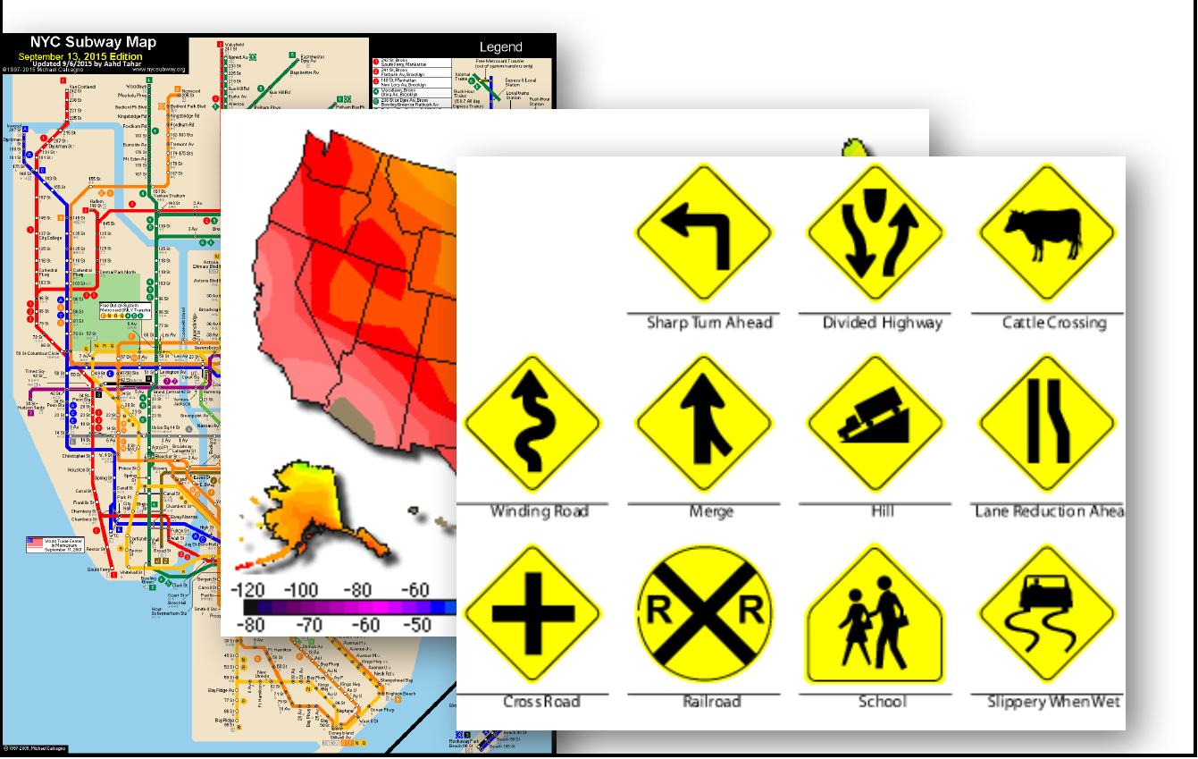
Visualization in Everyday Life

Slide 5
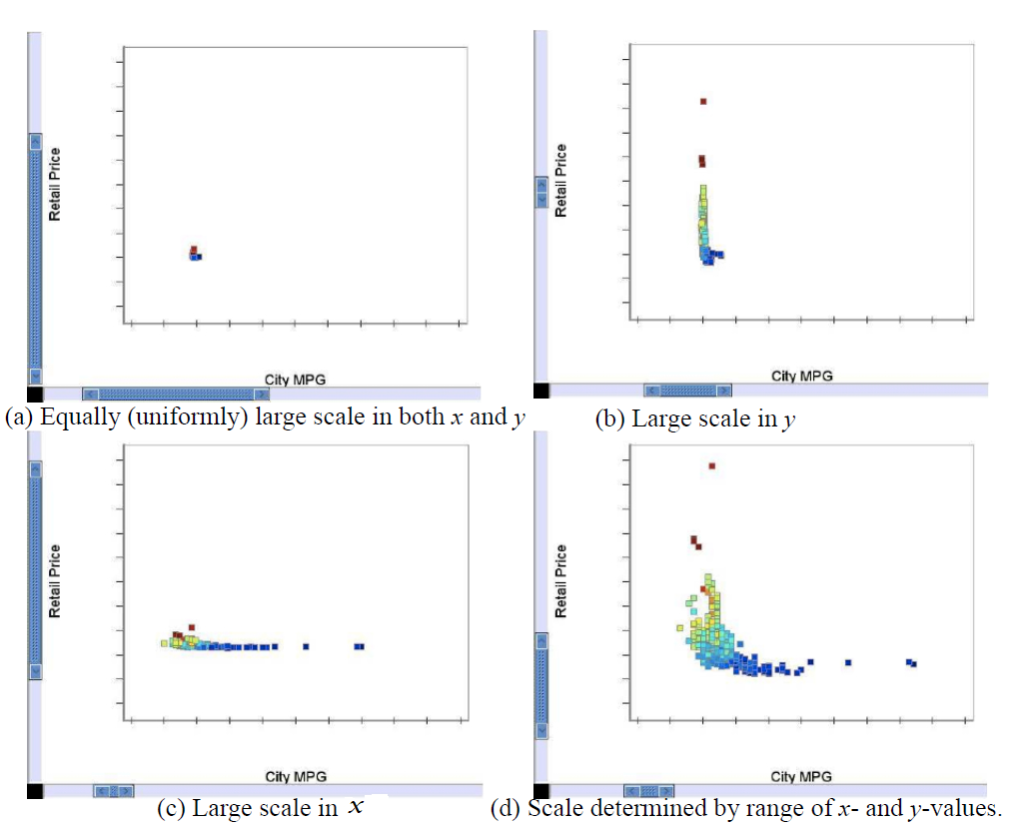
Some Observations …
Different insights can be gained from different visual representations
The same data set plotted with different scales can be perceived dramatically differently
…

Slide 6
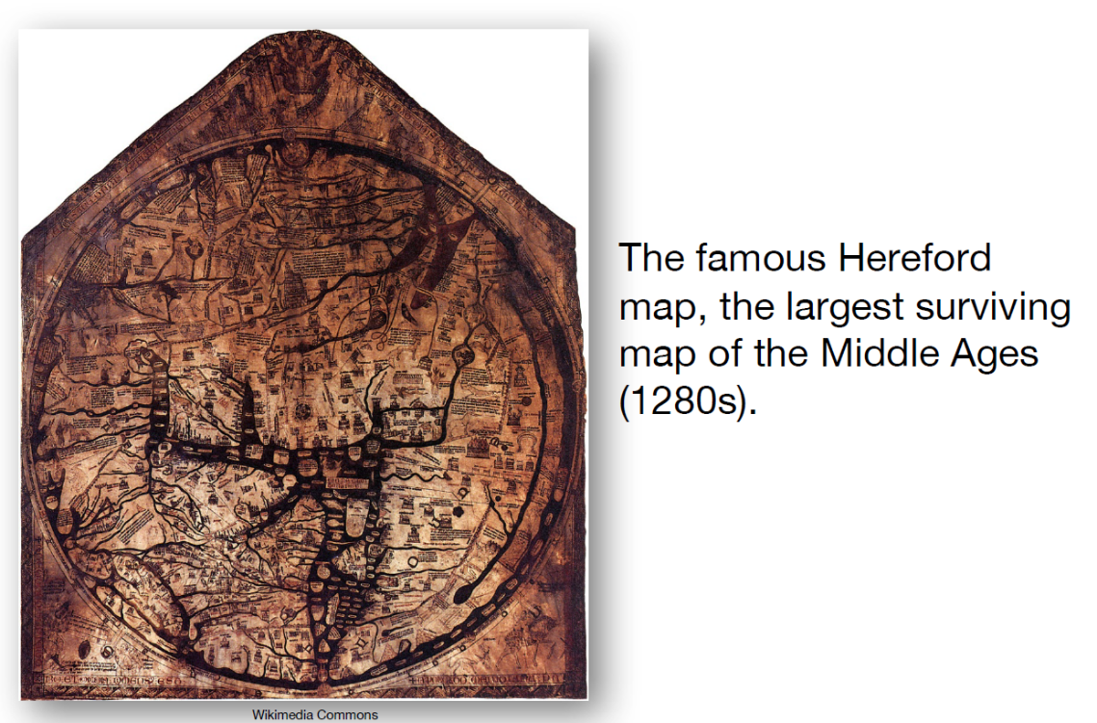
Visualization History Early Days
A display of the balance of trade between England and Norway/Denmark (1786).

Slide 7
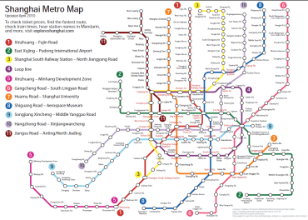
Visualization Convenience for modern life

Slide 8
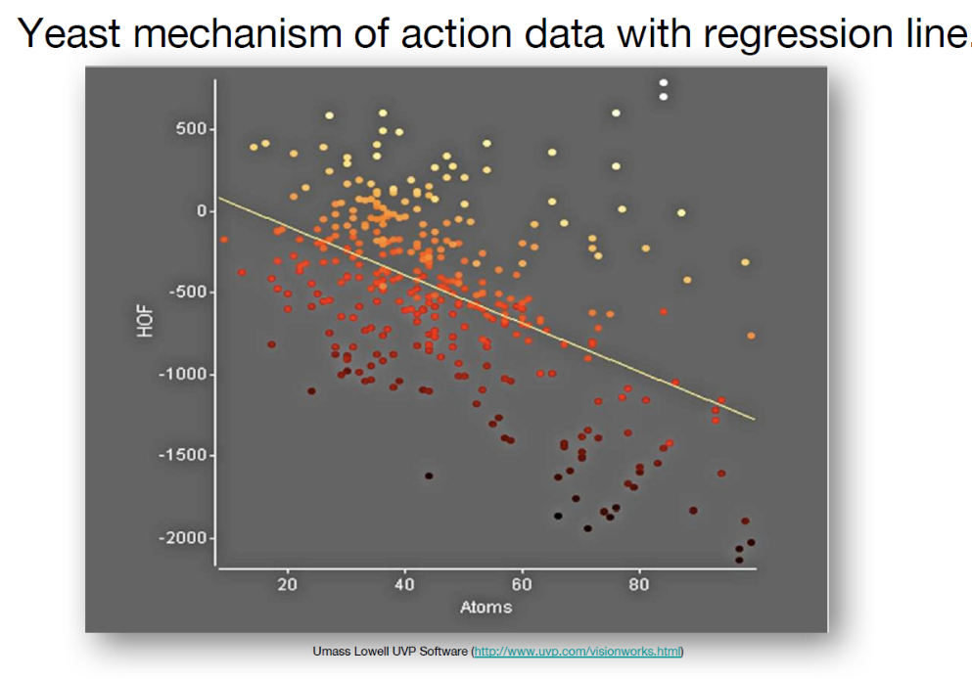
Visualization in data science

Slide 9
Visualization vs. Computer Graphics
The most important aspect of all visualizations is their connection to data. Computer graphics focuses primarily on graphical objects (points, lines, areas, and volumes) and the organization of graphic primitives; visualizations go one step further and are based on the underlying data, and may include spatial positions, populations, or physical measures.
Visualization is the application of graphics to display data by mapping data to graphical primitives and rendering the display.

Slide 10
Scientific Visualization (SciViz) vs. Information Visualization (InfoViz)
Initially, scientific visualization and information visualization were differentiated, although some no longer differentiate the two.
Both provide representations of data. However the data sets are most often different.
ScientificViz – typically concerned with data that has a well-defined representation in 2D or 3D space (i.e. data objects)
used for the clarification of well-known phenomena
InfoViz – typically concerned with abstract data
used for searching for interesting phenomena

Slide 11
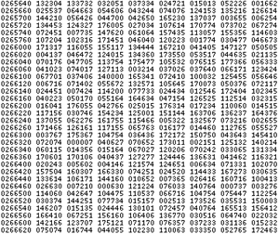
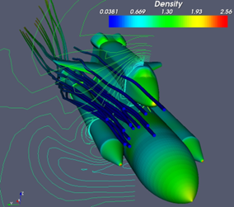

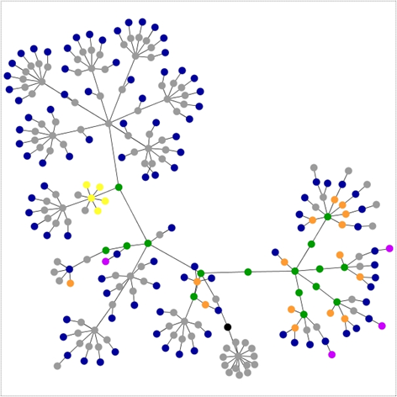
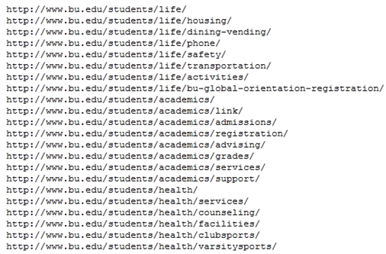
Activity 1: identify SciViz or InfoViz

Slide 12
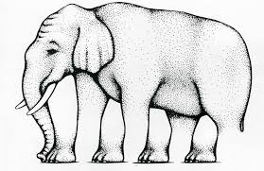
The Role of Perception
Activity 2: How many legs does this elephant have?

Slide 13
Visualization – User’s goals and activities
Presentation: The user is trying to convey some concept or set of facts to an audience.
Interactive Presentation: The user is providing a presentation as above but one that is interactive typically for an individual to explore.
Exploration: The user possesses a data set and wants to examine it to ascertain its contents and/or whether a particular feature or set of features is present or absent.
Confirmation: The user has determined or hypothesized that a given feature is present in the data and wants to use the visualization to verify this fact or hypothesis.

Slide 14
Common Visualization Tools
Hot Language (C/C++/Java/Python plus OpenGL)
Stat/math packages with graphics
R, MATLAB, …
Software libraries/toolkits/APIs
D3.js (JavaScript) https://d3js.org
Pandas plotting (Python)
https://pandas.pydata.org/pandas-docs/stable/visualization.html
Google Charts (JavaScript) https://developers.google.com/chart/
…

Slide 15
Case Study: U.S. Birth 2000 - 2014

Slide 16
DataSet of US Births 2000- 2014
 | year | month | date_of_month | day_of_week | births
0 | 2000 | 1 | 1 | 6 | 9083
1 | 2000 | 1 | 2 | 7 | 8006
2 | 2000 | 1 | 3 | 1 | 11363
3 | 2000 | 1 | 4 | 2 | 13032
4 | 2000 | 1 | 5 | 3 | 12558
5 | 2000 | 1 | 6 | 4 | 12466
6 | 2000 | 1 | 7 | 5 | 12516
7 | 2000 | 1 | 8 | 6 | 8934
8 | 2000 | 1 | 9 | 7 | 7949
9 | 2000 | 1 | 10 | 1 | 11668
Source: Alchemy User Guide => Sample Data Set -> US_births_2000-2014_SSA.csv
Data Format: the first 10 data entries as shown in table

Slide 17
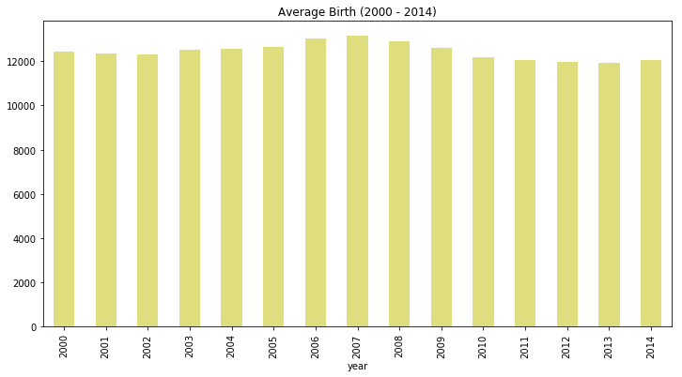
Average Birth 2000-2014

Slide 18
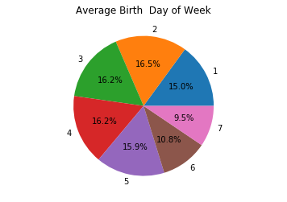
Average birth – Day of week
Sunday
Monday
Tuesday
Wednesday
Thursdays
Friday
Saturday

Slide 19
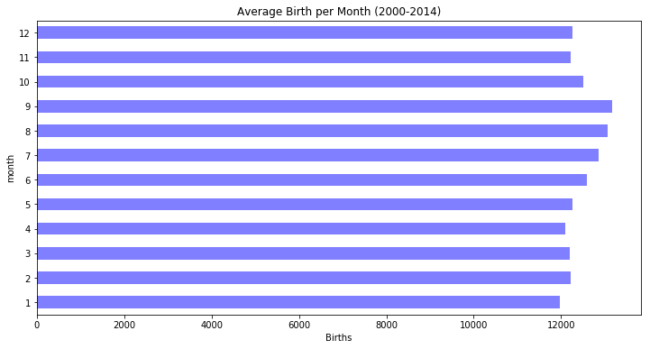
Average births - month
Note: This case was adopted from a student group’s first data analysis project.
Discussion questions:
What does visualization help? (advantages?)
In this case, what other charts could be added to improve the existing work?

Slide 20
Introduction to Pandas Visualization
import numpy as np
import pandas as pd
import matplotlib.pyplot as plt
A tutorial: https://www.tutorialspoint.com/python_pandas/python_pandas_visualization.htm

Slide 21
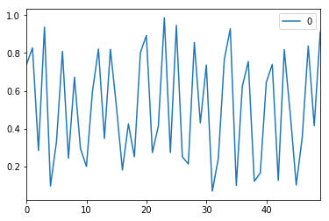
Plot lines
df = pd.DataFrame(np.random.rand(50))
df.plot.line()

Slide 22
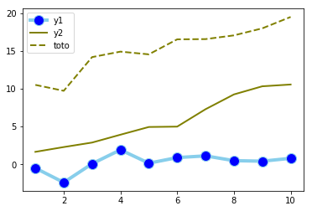
Plot multiple lines
# Data
df=pd.DataFrame({'x': range(1,11), 'y1': np.random.randn(10), 'y2': np.random.randn(10)+range(1,11),
'y3': np.random.randn(10)+range(11,21) })
# multiple line plot
plt.plot( 'x', 'y1', data=df, marker='o', markerfacecolor='blue', markersize=12, color='skyblue', linewidth=4)
plt.plot( 'x', 'y2', data=df, marker='', color='olive', linewidth=2)
plt.plot( 'x', 'y3', data=df, marker='', color='olive', linewidth=2, linestyle='dashed', label="toto")
plt.legend()

Slide 23
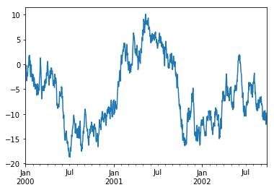
Basic Plotting – plot() method
ts = pd.Series(np.random.randn(1000),
index=pd.date_range('1/1/2000', periods=1000))
ts = ts.cumsum() #cumulative sum
ts.plot()
Note: actual graphs may vary due to the use of random numbers.

Slide 24
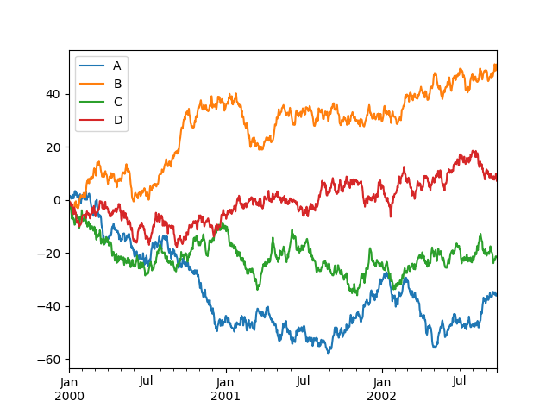
Plot all columns of DataFrame
df = pd.DataFrame(np.random.randn(1000, 4)
index=ts.index
columns=list('ABCD'))
df = df.cumsum()
plt.figure()
df.plot()
plt.figure(): create a figure object

Slide 25
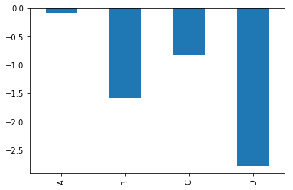
Bar Graph
plt.figure()
df.iloc[5].plot(kind='bar')
#df: see slide “plot all columns of DataFrame”

Slide 26
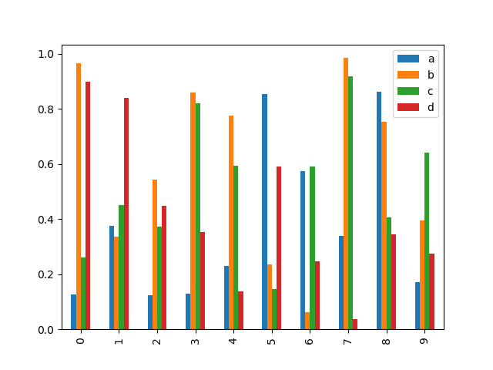
Multiple bar plot – bar () method
df2 = pd.DataFrame(np.random.rand(10, 4), columns=['a', 'b', 'c', 'd'])
df2.plot.bar()

Slide 27
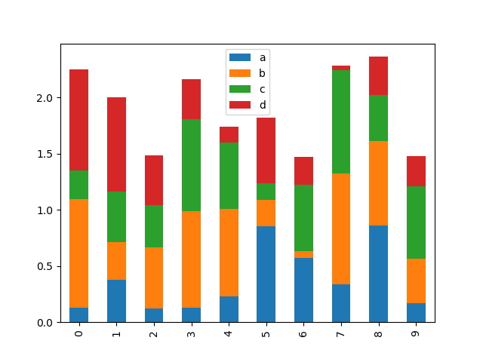
stacked bar plot
df2.plot.bar(stacked=True)

Slide 28
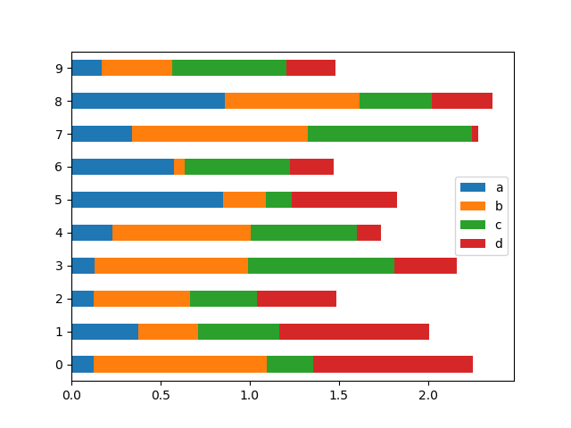
Horizontal (stacked) bar plot – barh() method
df2.plot.barh(stacked=True)

Slide 29
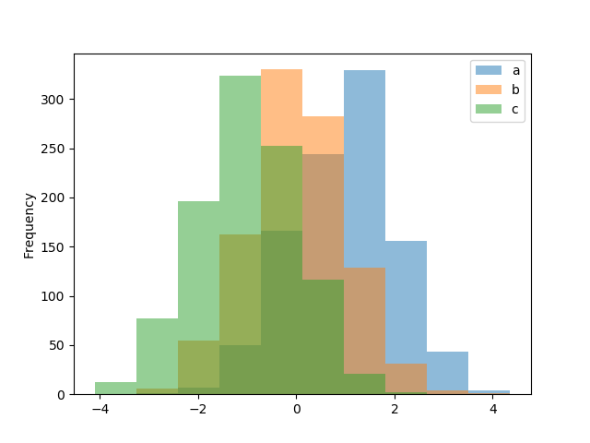
Histograms DataFrame.plot.hist() and Series.plot.hist()
df4 = pd.DataFrame({'a': np.random.randn(1000) + 1, 'b': np.random.randn(1000),
'c': np.random.randn(1000) - 1},
columns=['a', 'b', 'c'])
plt.figure();
df4.plot.hist(alpha=0.5)
Basic statistical concepts such as Histograms, box plots will be discussed in exploratory data analysis lecture.

Slide 30
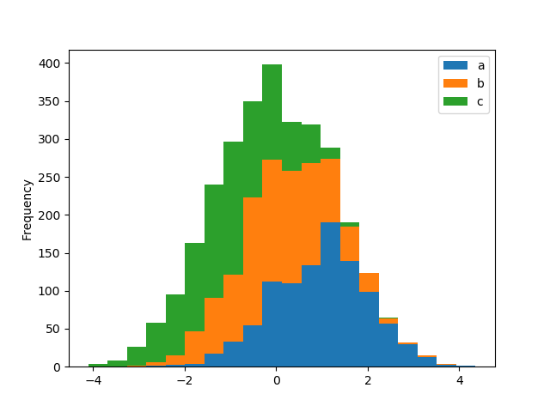
Histogram – stacked=True
plt.figure();
df4.plot.hist(stacked=True, bins=20)

Slide 31
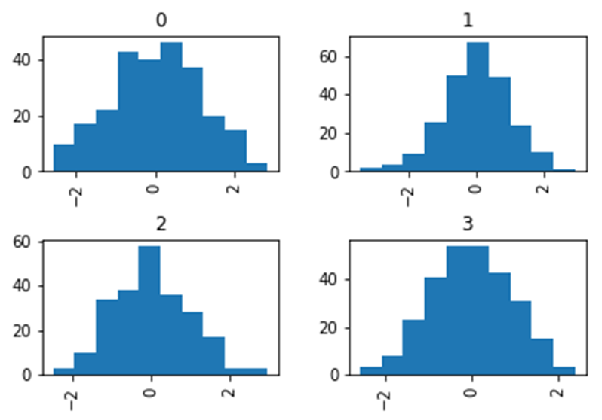
Grouped Histograms
data = pd.Series(np.random.randn(1000))
data.hist(by=np.random.randint(0, 4, 1000), figsize=(6, 4))

Slide 32
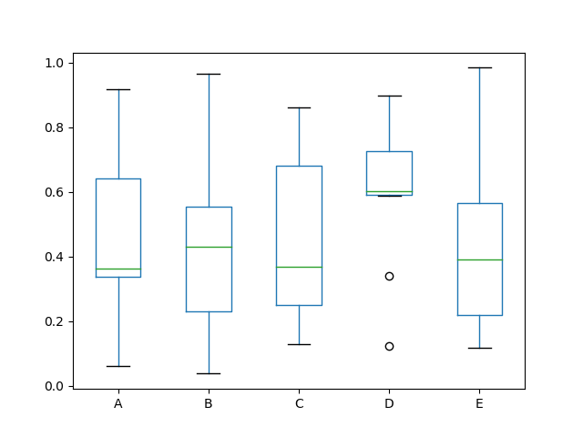
Box Plots
df = pd.DataFrame(np.random.rand(10, 5),
columns=['A', 'B', 'C', 'D', 'E'])
df.plot.box()

Slide 33
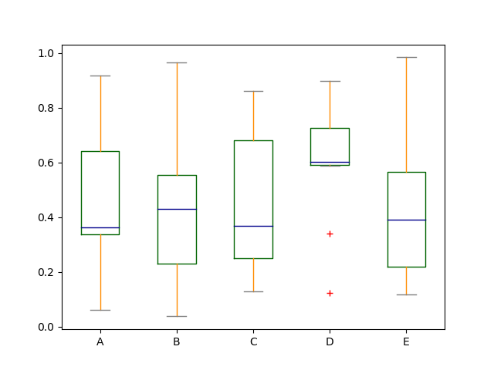
Colorized Box Plots
color = {'boxes': 'DarkGreen', 'whiskers': 'DarkOrange',
'medians': 'DarkBlue', 'caps': 'Gray'}
df.plot.box(color=color, sym='r+')

Slide 34
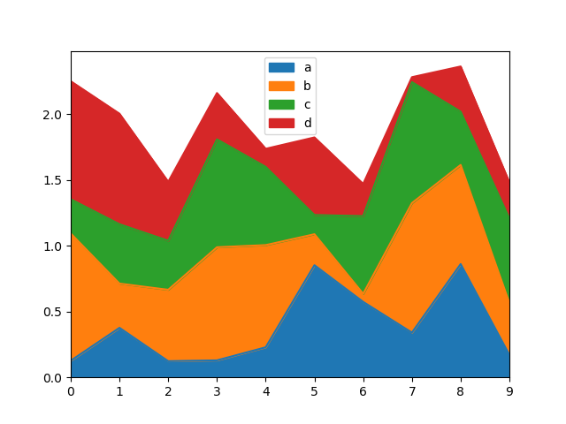
Area Plot
df = pd.DataFrame(np.random.rand(10, 4), columns=['a', 'b', 'c', 'd'])
df.plot.area()
Area plot: stacked by default

Slide 35
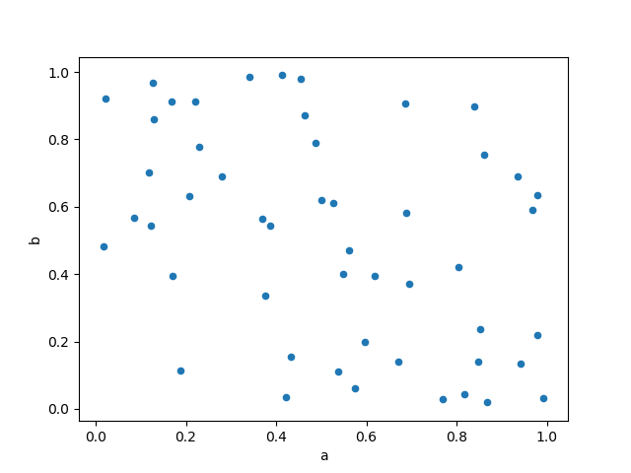
Scatter Plot
df = pd.DataFrame(np.random.rand(50, 4), columns=['a', 'b', 'c', 'd'])
df.plot.scatter(x='a', y='b')
#here column ‘c’ and ‘d’ not used

Slide 36
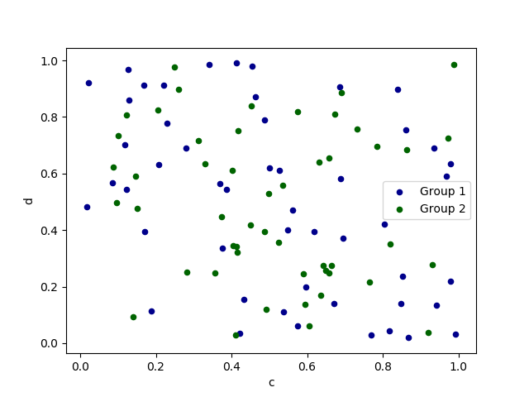
Scatter plot – multiple column groups
ax = df.plot.scatter( x='a', y='b', color='DarkBlue', label='Group 1')
df.plot.scatter( x='c', y='d', color='DarkGreen',
abel='Group 2', ax=ax)

Slide 37
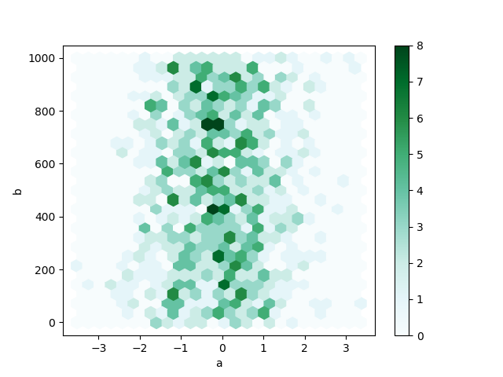
Hexagonal Bin Plot
df = pd.DataFrame(np.random.randn(1000, 2), columns=['a', 'b'])
df['b'] = df['b'] + np.arange(1000)
df.plot.hexbin(x='a', y='b', gridsize=25)

Slide 38
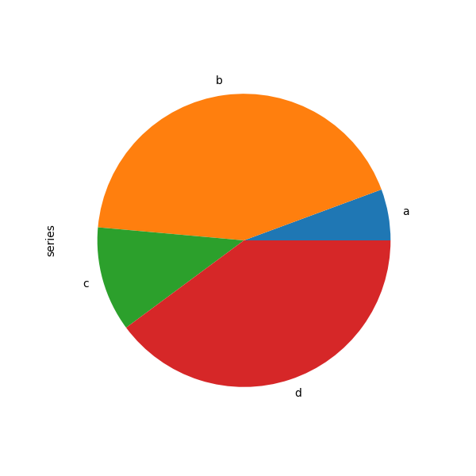
Pie plot
series = pd.Series(3 * np.random.rand(4),
index=['a', 'b', 'c', 'd’],
name='series')
series.plot.pie(figsize=(6, 6))

Slide 39
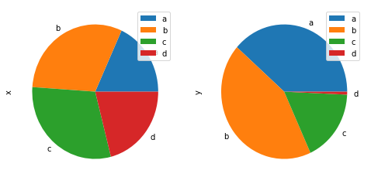
Pie plot for multiple columns
df = pd.DataFrame(3 * np.random.rand(4, 2),
index=['a', 'b', 'c', 'd'],
columns=['x', 'y'])
df.plot.pie(subplots=True, figsize=(8, 4))
Note: If subplots=True is specified, pie plots for each column are drawn as subplots.

Slide 40
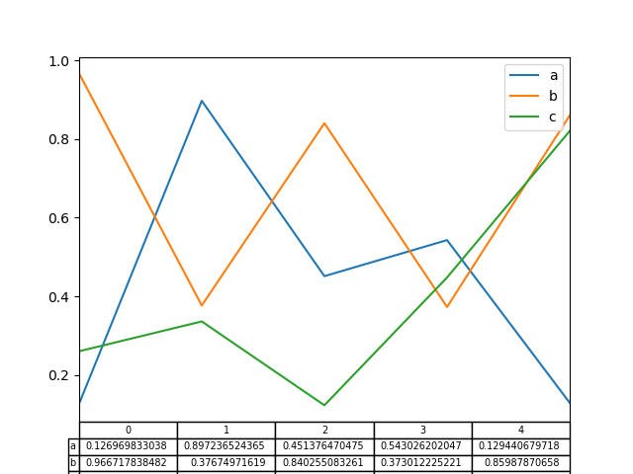
Plotting Tables
fig, ax = plt.subplots(1, 1)
df = pd.DataFrame(np.random.rand(5, 3), columns=['a', 'b', 'c'])
ax.get_xaxis().set_visible(False) # Hide Ticks
df.plot(table=True, ax=ax)

Slide 41
Summary
Basic concepts on data visualization
Introduction of basic Pandas methods for data visualization
Many more plotting methods: self-study
Reference: https://pandas.pydata.org/pandas-docs/stable/user_guide/visualization.html
Assignment: add visualization to Assignment #2
Next Lecture
Exploratory data analysis / descriptive statistics

